Slide 1


AGENTIC AI WORKSHOP
Chandra Mohan Dhanasekaran
Senior Cloud Infrastructure Architect
IBM Labs, Bengaluru

Slide 2
AGENDA
About Me
Introduction on Agentic AI Concepts
Agentic AI Use Cases
Understanding Workshop Setup
LangChain and LangGraph
Workshop
Q & A

Slide 3


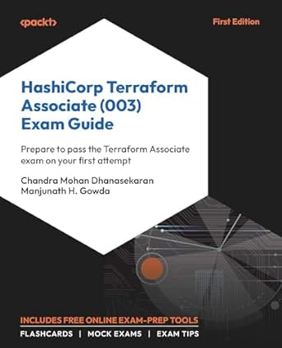
About Me
A Proud Dad of 2 Amazing Boys
Senior Cloud Infra Architect @ IBM Labs
16+ Years experience in software
Grafana & Kubernetes Fan
Docker Captain and HashiCorp Ambassador 2025
Event Speaker and Terraform Book Author
Passionate to connect with students and help building the right skills!

Slide 4
WHAT IS AGENTIC AI?
Agentic AI is an artificial intelligence system that can accomplish a specific goal with limited supervision. It consists of AI agents—machine learning models that mimic human decision-making to solve problems in real time. In a multiagent system, each agent performs a specific subtask required to reach the goal and their efforts are coordinated through AI orchestration.

Slide 5
ADVANTAGES
Autonomous
Proactive
Specialized
Adaptable
Intuitive

Slide 6
HOW AGENTIC AI WORKS?
Perception
Reasoning
Goal Setting
Decision Making
Execution
Learning & Adaptation
Orchestration

Slide 7
FOOD FOR THOUGHT !!!
Agentic AI vs Generative AI
Agentic AI and AI Agents

Slide 8
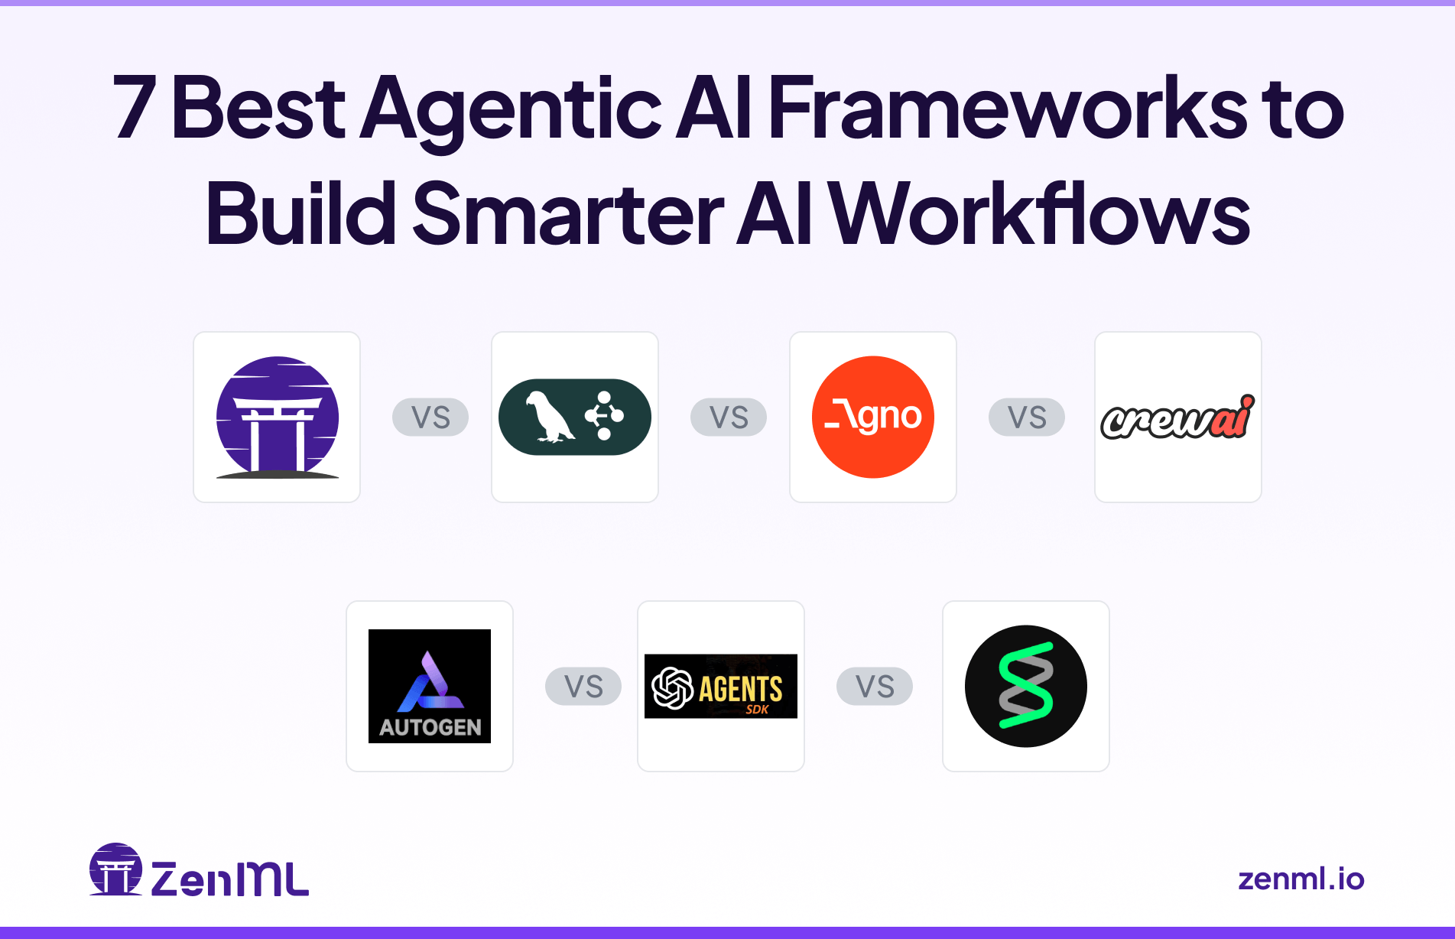

Slide 9
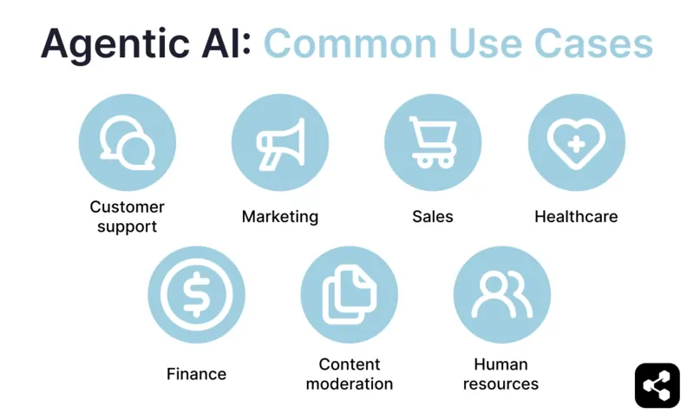

Slide 10







student01
student11
student02
student12
studentxx
studentyy
workshop-master
AGENTIC AI WORKSHOP – HIGH LEVEL SETUP

Slide 11





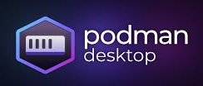

Internet

Slide 12
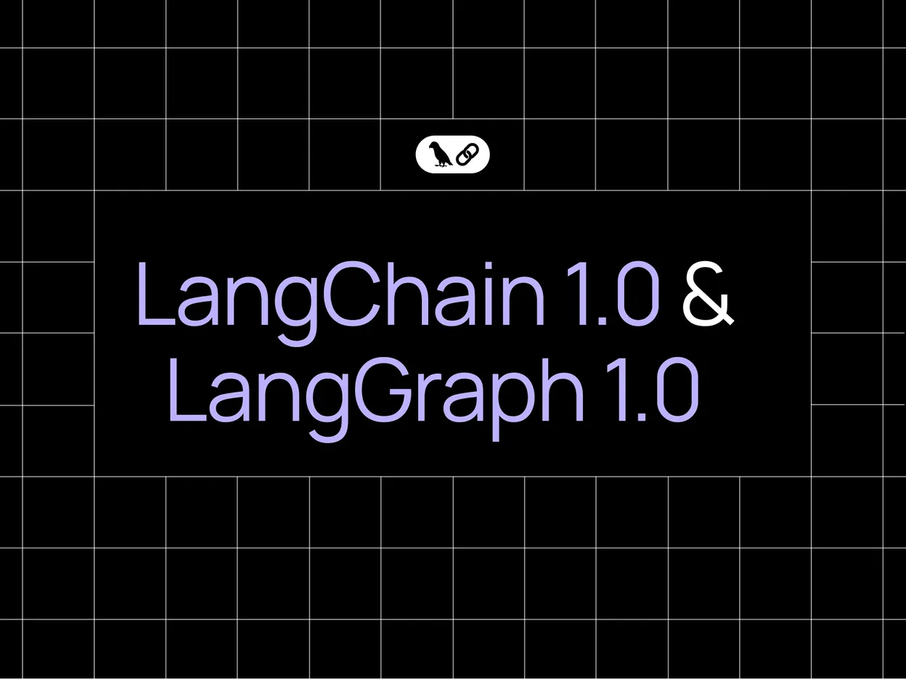
LangChain & LangGraph
LangChain is the fastest way to build an AI agent — with a standard tool calling architecture, provider agnostic design, and middleware for customization.
LangGraph is a lower level framework and runtime, useful for highly custom and controllable agents, designed to support production-grade, long running agents

Slide 13

WORKSHOP
TIME!!

Slide 14



Slide 15
